Slide 1


DISSERTATION SEMINAR
On
DESIGN AND IMPLEMENTATION OF DRIVER DROWSINESS AND ALCOHOL INTOXICATION DETECTION USING RASPBERRY PI
Submitted by
Mr. Pandurang.N.Kathar
PG Student
Under the Guidance of
Prof. D.L.BHUYAR
In partial fulfillment for the award of
M.E. Degree in Electronics and Tele-Communication Engineering
DR. BABASAHEB AMBEDKAR MARATHWADA UNIVERSITY
AURANGABAD (M.S.)
Department of Electronics and Tele-Communication Engineering
CSMSS Chatrapati Shahu College of Engineering,
Aurangabad Year(2015-16)

Slide 2
CONTENTS
Introduction
Literature Survey
Propose system
Performance analysis
Conclusion
References

Slide 3
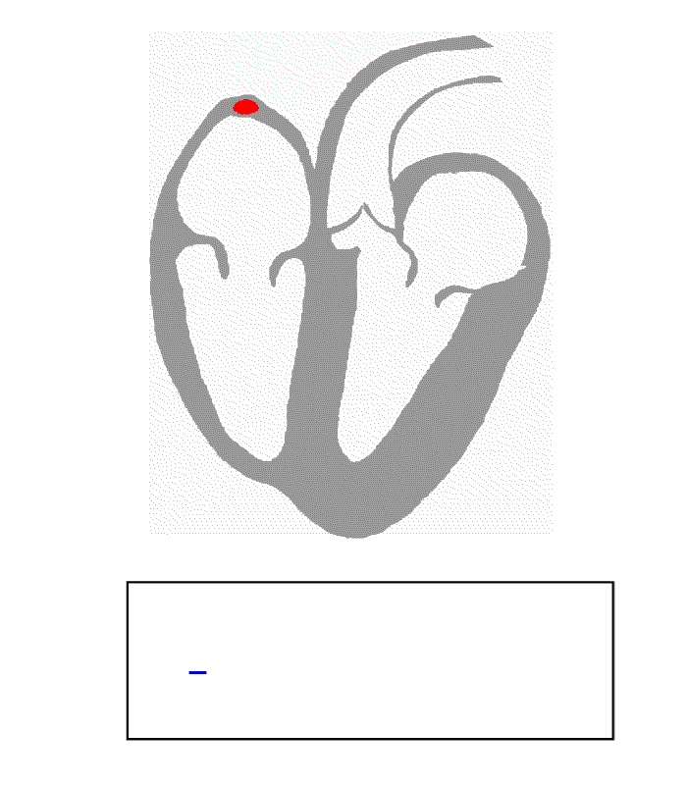
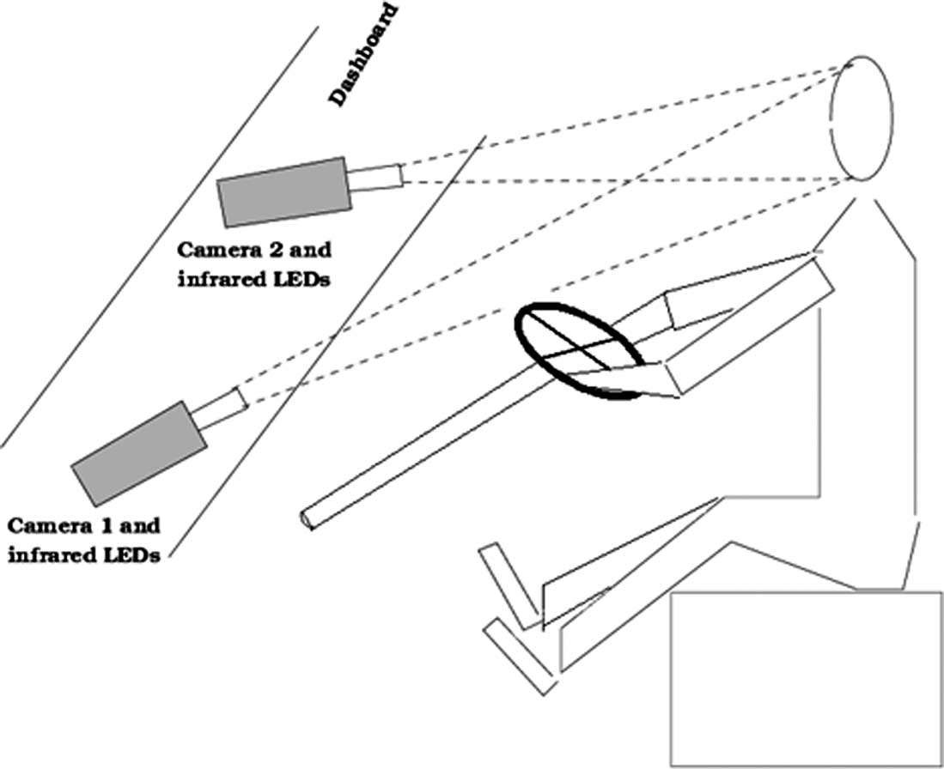
INTRODUCTION
In this system for design to detect the drowsiness and alcohol intake of car driver and perform necessary actions on real time.
The design is based on computer vision and embedded system application principles. For the detection of drowsiness, it detects the eye closing rate of the person & detect the alcoholic Intoxication of the driver.

Slide 4
NEED OF PROJECT
To reduce the number of accidents due to driver’s Drowsiness and alcohol intake to increase the transportation safety.
A drowsy/sleepy driver is unable to determine when he/she will have an uncontrolled sleep onset.
The real time continuously monitoring is required for a Driver in Drunk or fatigue/drowsy.
To overcome all problem made a system Driver drowsiness detection and alcohol detection from accident by warning the driver.

Slide 5
THEME OF PROJECT
USB Camera Capture Real Time Images of driver continuously and send to Raspberry pi for processing.
Raspberry pi is used to detect whether Eyes are Open or Closed.
Alcohol Sensor detect whether driver is drunk or not using MQ-3 sensor.
With Input of both signals Arduino UNO is used to convert electrical signal into digital value.
Arduino UNO displays these status and value on a LCD.
Status of all parameter display on monitor section .
The Power requirement for Raspberry pi & Arduino UNO is 3.3V TO 5.0V Only.

Slide 6
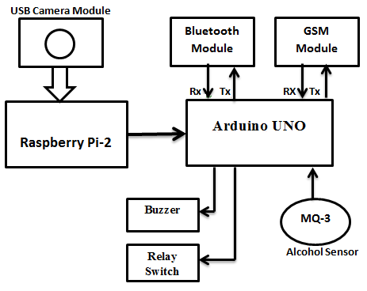
SCENARIO OF THE SYSTEM

Slide 7
LITERATURE SURVEY
SR.NO | AUTHOR NAME AND YEAR | PUBLICATIONS | SENSORS USED | USED TECHNICS | EXPERIMENTAL RESULTS
1 | D.Sowmya & I.Suneetha (2014) | IJCA 102(2) (2014) PP- 21-27 | ARM, MQ3, GPS, GSM, MEMS. | Eye Blink sensor and Alcohol sensor MQ3.This system working on ARM LPC2148 processor. | Using Eye Blink sensors it detect driver drowsiness & also detect alcohol, with the help of GSM/GPS detect accident location.
2 | Ashutosh U. Jadhav.(2015) | IJAREEIE 4(7) (2015) PP- 6616-6623 | ARM, MQ3, Automobile GPS, GSM. | To detect Lane violation and avoid it. To detect the Alcohol and Drowsiness of the driver. | Detect whenever the lane is departed a warning is displayed to driver eyes on MATLAB programming with the help of Eyes blink sensor & also detect Alcohol .
3 | L. Nikitha (2015) | International Journal of Advanced Technology in Engg.& Science.3(01)2015 PP-707-7014 | ECG,ARM, Alcohol sensor, GSM, Eye Blink sensor | Measuring heart beats using ECG sensor. Detect Eyes blink rate using Eye blink sensor. Detect amount of alcohol using alcohol sensor. | In this system it detect the variation of heart beat and also detects eye blink rate of driver and detect amount of alcohol using alcohol sensor.
4 | Naveen M, Sudarvizhi S (2015) | International Journal of Research in Engineering & Advanced Technology. 3(01) 2015 PP-211-216 | Finger vein authentication, GSM, Raspberry pi, Arduino UNO. | Biometric system is used for alcohol detection, Eyes are detected with the help of camera which controlled by raspberry pi module. | In this system alcohol detection is measured by using just press their finger in the biometric system. Eyes pair is detected by the system with help of camera module which is connected to raspberry pi.

Slide 8
SR.NO | AUTHOR NAME AND YEAR | PUBLICATIONS | SENSORS USED | USED TECHNICS | EXPERIMENTAL RESULTS
5 | Dhaval Pimplaskar (2013) | International. Journal of Engineering Research and Applications.3(05) 2013.PP-1780-1787 | MATLAB Blink detection, Eye tracking | With the help of MATLAB we detect the eyes position and blinking rate in real time. | In this method tracking of eye position within high and low condition and also used for detection of eye blinking in real time environment
6 | Saeid. Fazli, and Parisa. Esfehani | International Conference on Advances in Computer and Electrical Engineering. Nov. 17-18, 2012 Manila (Philippines) | MATLAB, fatigue detection, face detection, eye detection. | It detects face and calculate eyes region on the face with help of MATLAB and shows the result. | In this system detects face in real time with the help of image processing in MATLAB. Also detects the eye blinking rate and shows eyes are open or closed.
7 | Varsha Eknath Dahiphale. (2015) | International Journal of advanced Research in Electronics and Communication Engineering. 4(09) 2015 PP-2331-2334 | Face detection; OpenCV; Raspberry Pi; | With the help of camera it capture Images and detect eyes with the help of Raspberry pi. | In this system detection of fatigue level of driver and alert, and also detects face and eyes with the help of Raspberry pi.
8 | Prachi H. Chokhani. (2015) | JETIR,2(03) -2015 | Fatigue, Drowsiness detection, alcohol intoxication, real time detection | It detects face and also detect the alcohol level of driver with help of Raspberry pi. | This system will provide alertness to driver if in case drowsiness is detected by the system and will switch off the ignition of the car through relay switch to prevent drunk driving

Slide 9
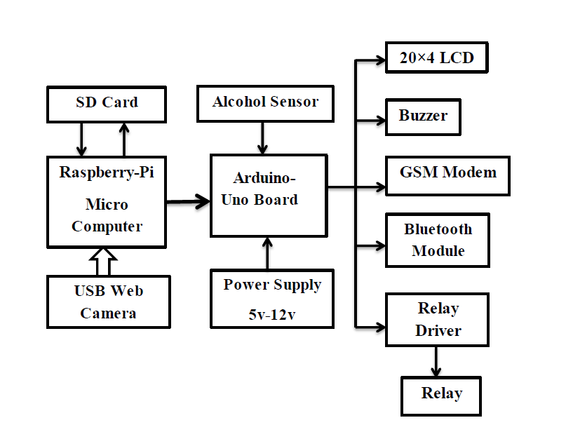
PROPOSED SYSTEM
BLOCK DIGRAM OF SYSTEM

Slide 10
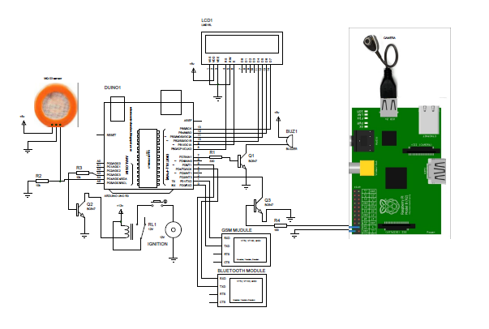
SYSTEM CIRCUIT DIAGRAM

Slide 11
HARDWARE IMPLEMENTATION
Raspberry Pi Model B+
Arduino Uno Module
Alcohol sensor MQ-3
USB Camera (8 Mega Pixel)
GSM Modem (SIM-900)
Bluetooth Transmitter
LCD Display (20*4)
Some Indicators
Connectors:
HDMI to VGA connector
Connecting Wires

Slide 12
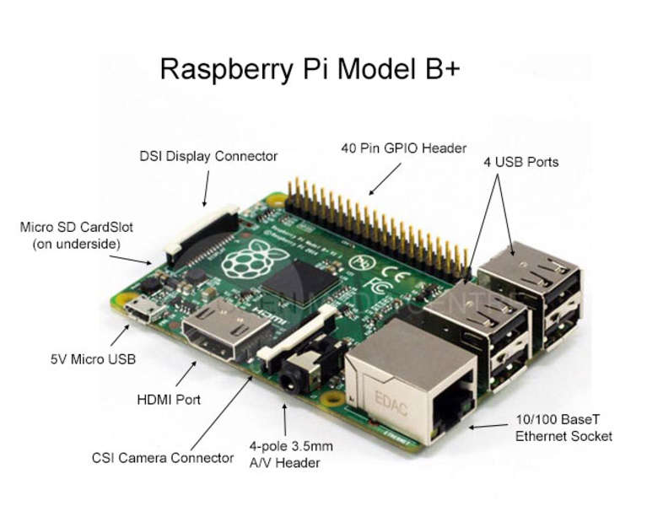

Slide 13
MODEL B HARDWARE GENERAL SPECIFICATIONS
4 USB ports
40 GPIO pins
Full HDMI port
Ethernet port
Combined 3.5mm audio jack and composite video
Camera interface (CSI)
Display interface (DSI)
Micro SD card slot
Video Core IV 3D graphics core

Slide 14
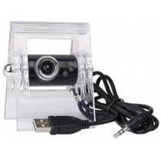
USB CAMERA MODULE
FEATURES:
Compliant to USB2.0 and USB Video Class
Support still image capture and Video Streaming
Convert Bayer RGB to YUY2 color space
Video Resolution: 8.0M pixel
Gain and offset adjustment in RGB space
Input Voltage: standard 3.3V ~ 5V

Slide 15
DRIVER DROWSINESS DETECTION TECHNIQUES
Detection using existing technologies in order to detect and manage driver fatigue.
Different Parameters:-
Analyzing changes in eye activity.
Analyzing changes in brain wave or EEG.
Facial expressions
Good detection accuracy is achieved by these techniques

Slide 16
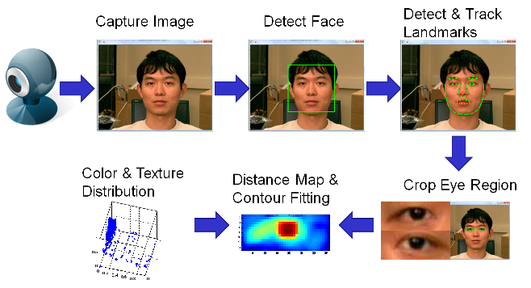
EYE DETECTION AND CROPPING PROCESS

Slide 17
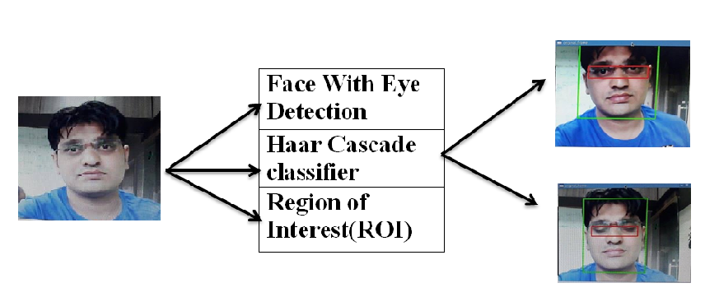
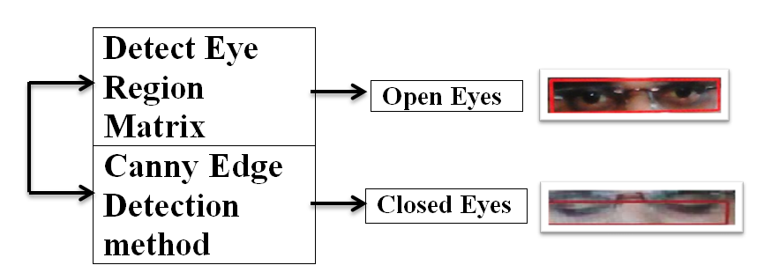
PROCESSING OF EYE DETECTION

Slide 18
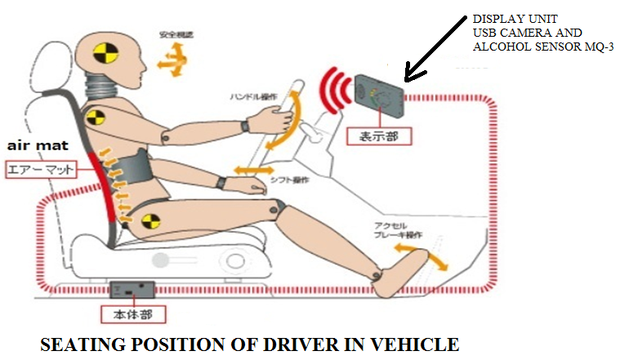
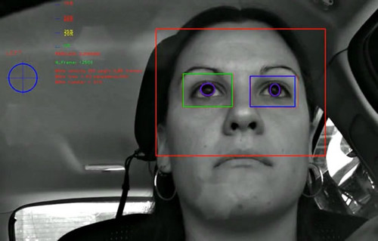
CAMERA MODULE DETECTION IN CAR
.

Slide 19
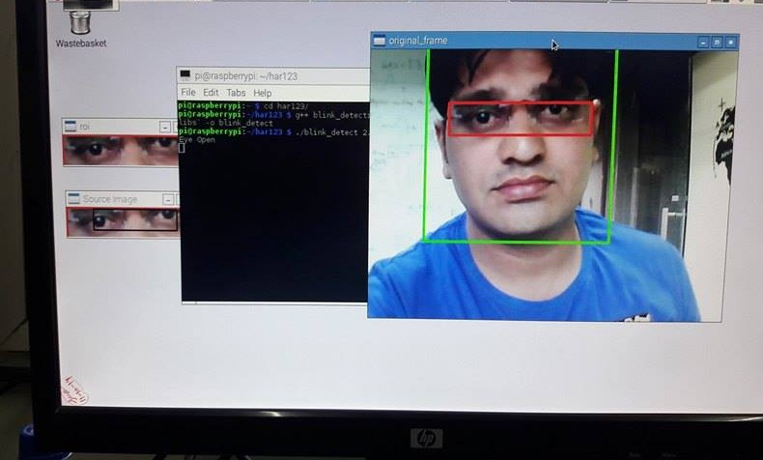
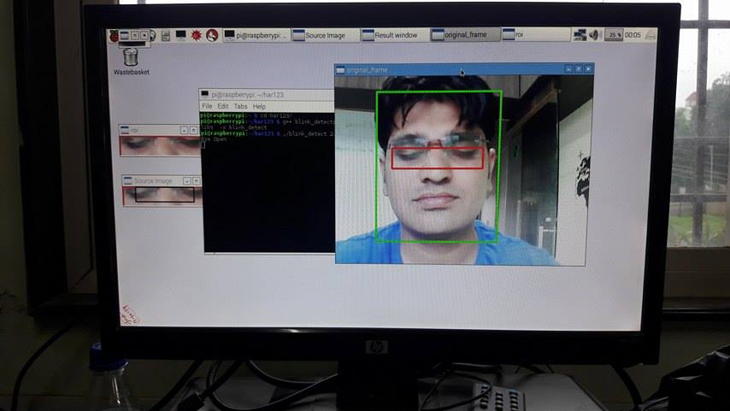
FACE/EYE DETECTION IN OUR PROJECT

Slide 20
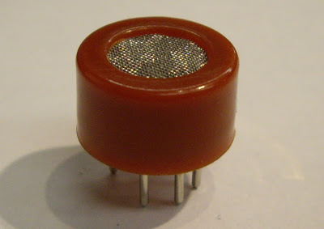
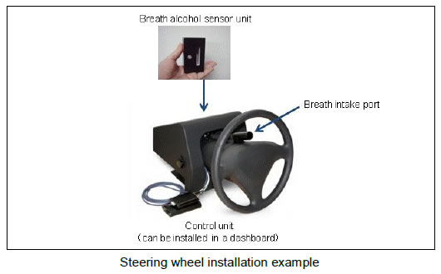
ALCOHOL SENSOR MQ-3
A Semiconductor sensor for Alcohol detection
High sensitivity and good selectivity for Ethanol Vapors.
Suitable for detecting alcohol concentration in breath ,like a common breathalyzer(portable alcohol detection).
Provides an analog resistive output based on alcohol concentration.
The resistance of the sensor reduces when alcohol concentration increases.
The sensor gives output as per the condition of the breath through the logic circuits which is sent to the Arduino Uno.
Alcohol detection range is 10~1000 ppm.
In this system we get different alcoholic samples with the help of aftershave lotion.

Slide 21
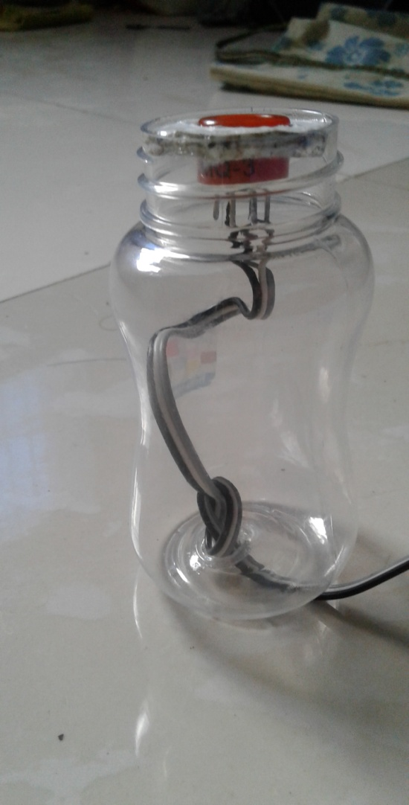
ALCOHOL SENSOR MQ-3
STRUCTURE OF MQ-3
SPECIFICATION OF MQ-3
Power supply: 5V
Interface type: Analog
High sensitivity to alcohol and small sensitivity to Benzine
Fast response and High sensitivity
Stable and long life
Simple drive circuit
Size: 36.4x26.6mm(1.43"x1.05“)

Slide 22
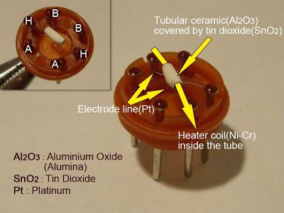
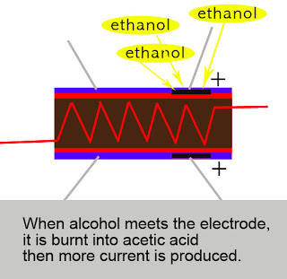
CONSTRUCTION OF MQ-3

Slide 23
SYSTEM OUTPUTS ON LCD DISPLAY
Output | Level Of Drunkenness
 | 0% -20% | 21%-40% | 41%-60% | 61%-99%
LCD Display | “INTOXICATION” | “SLIGHTLY DRUNK” | “DRUNKENNESS” | “OVER LIMIT DRUNK”
Buzzer Indication | OFF | OFF | ON | ON
Ignition System | Enable | Enable | Enable | Disable
Message Send by GSM | NO | No | NO | YES

Slide 24
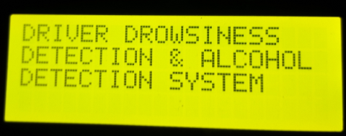
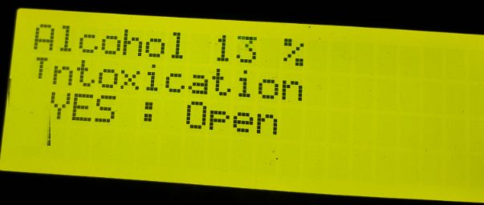
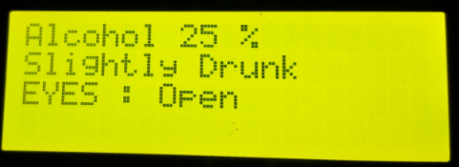
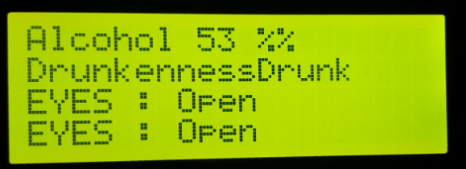
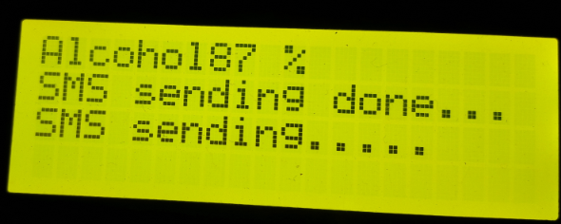
SYSTEM LCD OUTPUT FOR ALCOHOL DETECTION

Slide 25
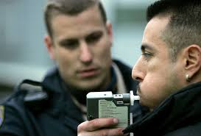
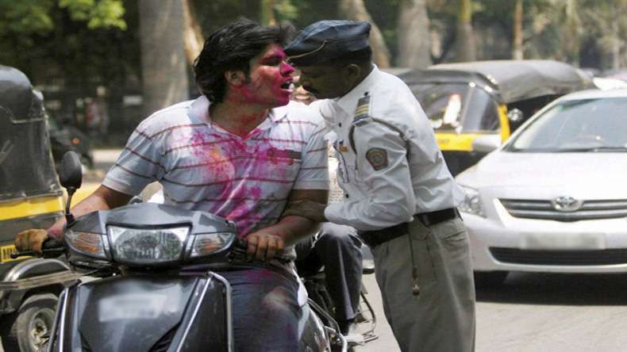
TECHNOLOGY DIFFERENCE

Slide 26
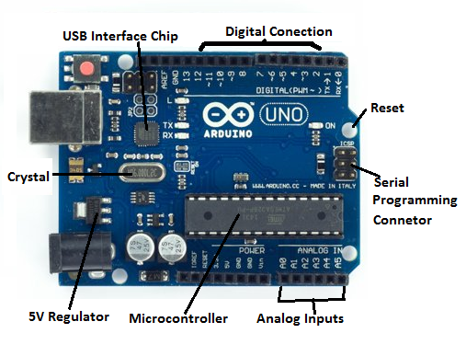
ARDUINO UNO MODULE
FEATURES :
Microcontroller- ATmega328
Operating Voltage- 5V
Input Voltage (Recommended) 7-12V
Input Voltage (limits) 6-20V
Digital I/O Pins 14 (of which 6 provide PWM output)
Analog input Pins 6
DC Current per I/O Pin 40 mA
DC Current for 3.3V Pin 50 mA
Flash Memory 32 KB (ATmega328) of which 0.5 KB used by boot loader
SRAM 2 KB (ATmega328)
EEPROM 1 KB (ATmega328)
Clock Speed 16 MHz

Slide 27
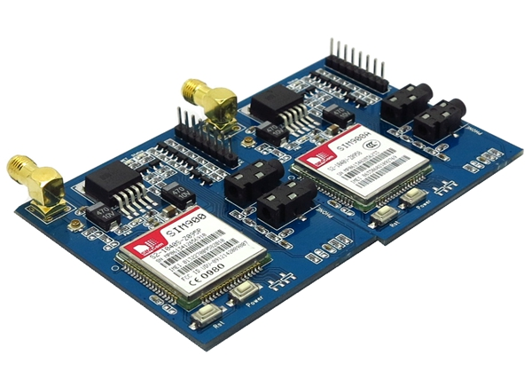
GSM MODULE(SIM 900)
Features:
Module No: Simcom SIM900 2G Module
Power Supply: +5V
Fully compatible with Arduino/Raspberry Pi/AVR/PIC/ARM/FPGA
Free serial port connecting, you can select Hardware/Software Serial port control
Super capacitor power supply for the RTC
Not only can use the button for power on, but also can use the digital pin of Arduino to power on and reset the SIM900 module
Quad-Band GSM(2G) GPRS/EDGE 850/900/1800/1900 MHz

Slide 28
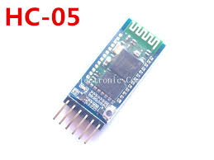

BLUETOOTH MODULE
Simple protocol, global implementation
Data rates of 25kbps to 250kbps
Minimum Bandwidth required- 3MHz
Point to multipoint communication
Easily available in all mobile phones

Slide 29
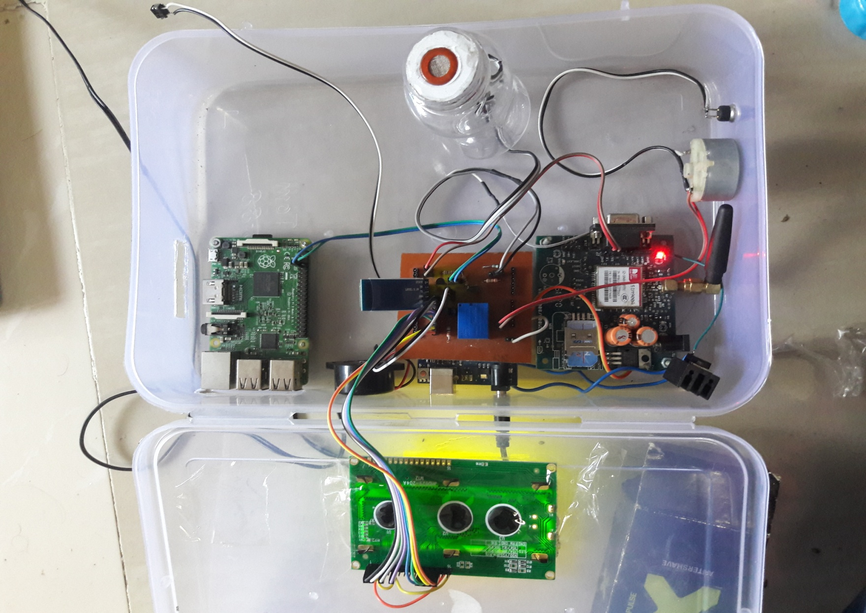
SYSTEM PHOTO

Slide 30
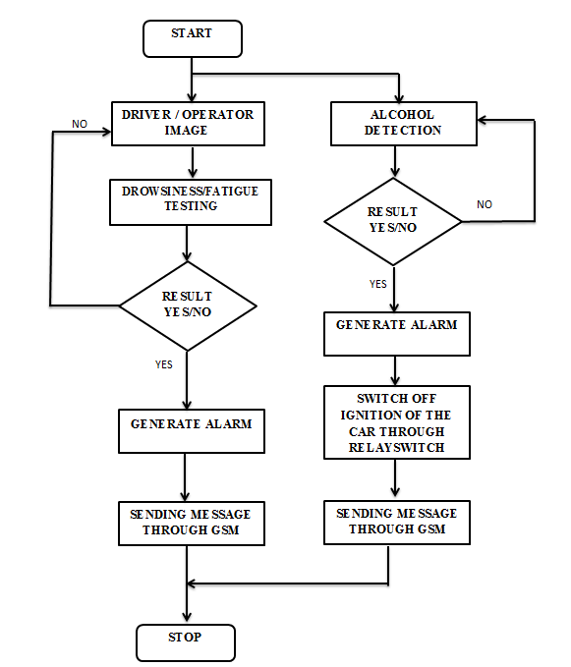
SYSTEM FLOW CHART

Slide 31
This method can also be used for small moving objects.
The template matching algorithm decreases the computation time as the Region of interest (ROI) is dynamically found out.
The above automated object detection and tracking system can work perfectly under low lighting conditions so it can be used in surveillance and video conferencing.
There is good accuracy for alcohol detection in any condition.
ADVANTAGES

Slide 32
APPLICATIONS
This system can be implemented in the larger vehicles like trucks and buses and further more vehicles like passenger and cargo trains.
This proposed system can be used as the warning system to avoid collisions in the National Highways.
This system can be further developed using the image processing technique to analyze the driver’s facial expressions to understand the different situations that can arise while driving.
Alcohol detection is helps for Police department..

Slide 33
CONCLUSION
The proposed system deals with detection of alcohol and drowsiness using sensors to get the notification message with help of GSM modules and accordingly precautions are taken. The system works well even in case of drivers wearing spectacles and under low light conditions also. The Algorithm we implemented works exceptionally well in all the circumstances. We have discovered that upgrading hardware gives better results.

Slide 34
REFRENCES
Dwipjoy Sarkar, Atanu Chowdhury, A Real Time Embedded System Application for Driver Drowsiness and Alcoholic Intoxication Detection, Int J Eng Trend Technol (IJETT). 2014; 10(9): 461–465p.
Prasanthi TD, Rajasekhar K, Janardhana Rao TV, et al. Design of ARM based face Recognition system using Open CV library, Int J Adv Res Comp Technol (IJARCET). 2012; 01(9): 233–240p.
Varsha E dahiphale, Sathyanarayana R. Computer Vision System for Driver Fatigue Detection, Int J Adv Res Electr Commun Eng (IJARECE). 2015; 04(9): 2331–2334p.
Saeid Fazli, Parisa Esfehani, Tracking Eye State for Fatigue Detection, International Conference on advanced in Computer and Electrical Engineering (ICACEE’2012), 2012, 17–18p.
Lorraine Saju, Christeena Jestine, Farhana Yasmin, et al. Drowsiness Detection System for Drivers using Haartraining and Template Matching, Int J Eng Appl Sci Technol. April - May 2016; 1(6): 106–110p.
Dhaval Pimplaskar, Nagmode MS, Atul Borkar, Real Time Eye Blinking Detection and Tracking Using OpenCV, Int J Eng Res Appl. 2013; 03(05): 1780–1787p.
Naveen M, Sudarvizhi S. Finger Vein Recognition Based Driver Authentication and Alertness System Using GSM, Int J Res Eng Adv Technol (IJREAT). 2015; 3(1): 211–216p.

Slide 35
PAPERS PUBLISHED
“A REVIEW ON DRIVER DROWSINESS AND ALCOHOL DETECTION SYSTEM” in (IJESRT), volume 5, issue 2, Feb-2016.
“DROWSINESS DETECTION AND ALCOHOL INTOXICATION FOR CAR ASSISTED DRIVER SYSTEM USING RASPBERRY PI ” in STM Journal-Unpaid (Acceptance ) sept-2016.
“DESIGN AND IMPLEMENTATION OF DRIVER DROWSINESS AND ALCOHOL INTOXICATION DETECTION USING RASPBERRY PI”, in (IJIRCCE) volume 4, issue 8, August 2016.

Slide 36
THANK YOU!!!

